Slide 1
Transfer Learning
By Modar Alfadly
[IVUL , KAUST 2017]

Slide 2
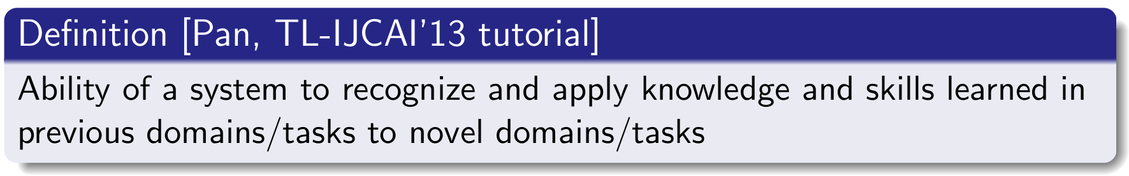
What is Transfer Learning
“Intro to TL and Domain Adaptation” [Amaury Habrard, EPAT 2014]

Slide 3
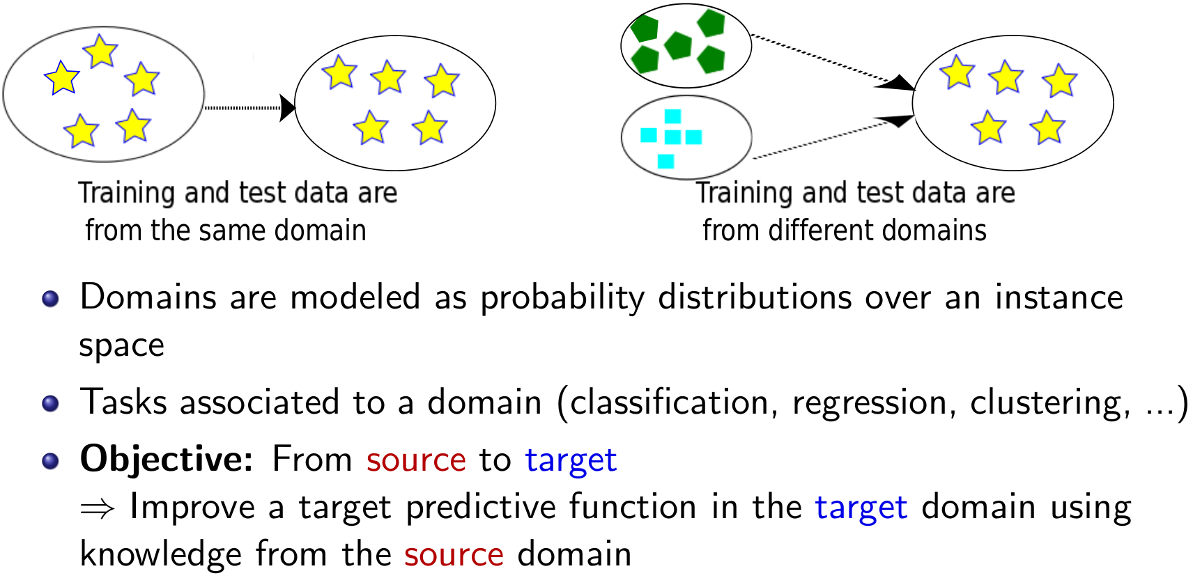
What is Transfer Learning
“Intro to TL and Domain Adaptation” [Amaury Habrard, EPAT 2014]

Slide 4
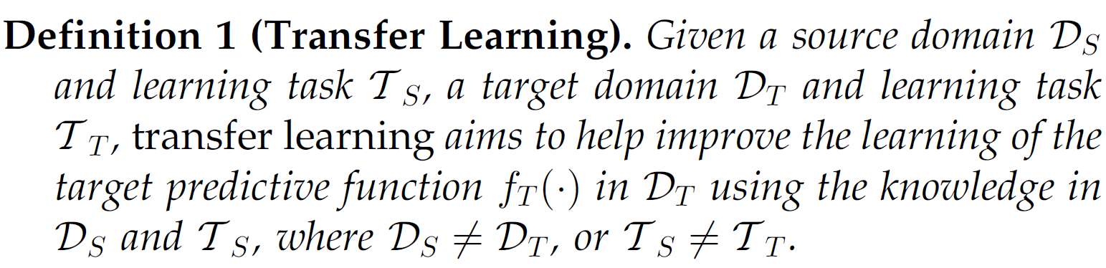
What is Transfer Learning
“Intro to Transfer Learning” [Dr. Wu Xinxiao, BIT 2014]

Slide 5
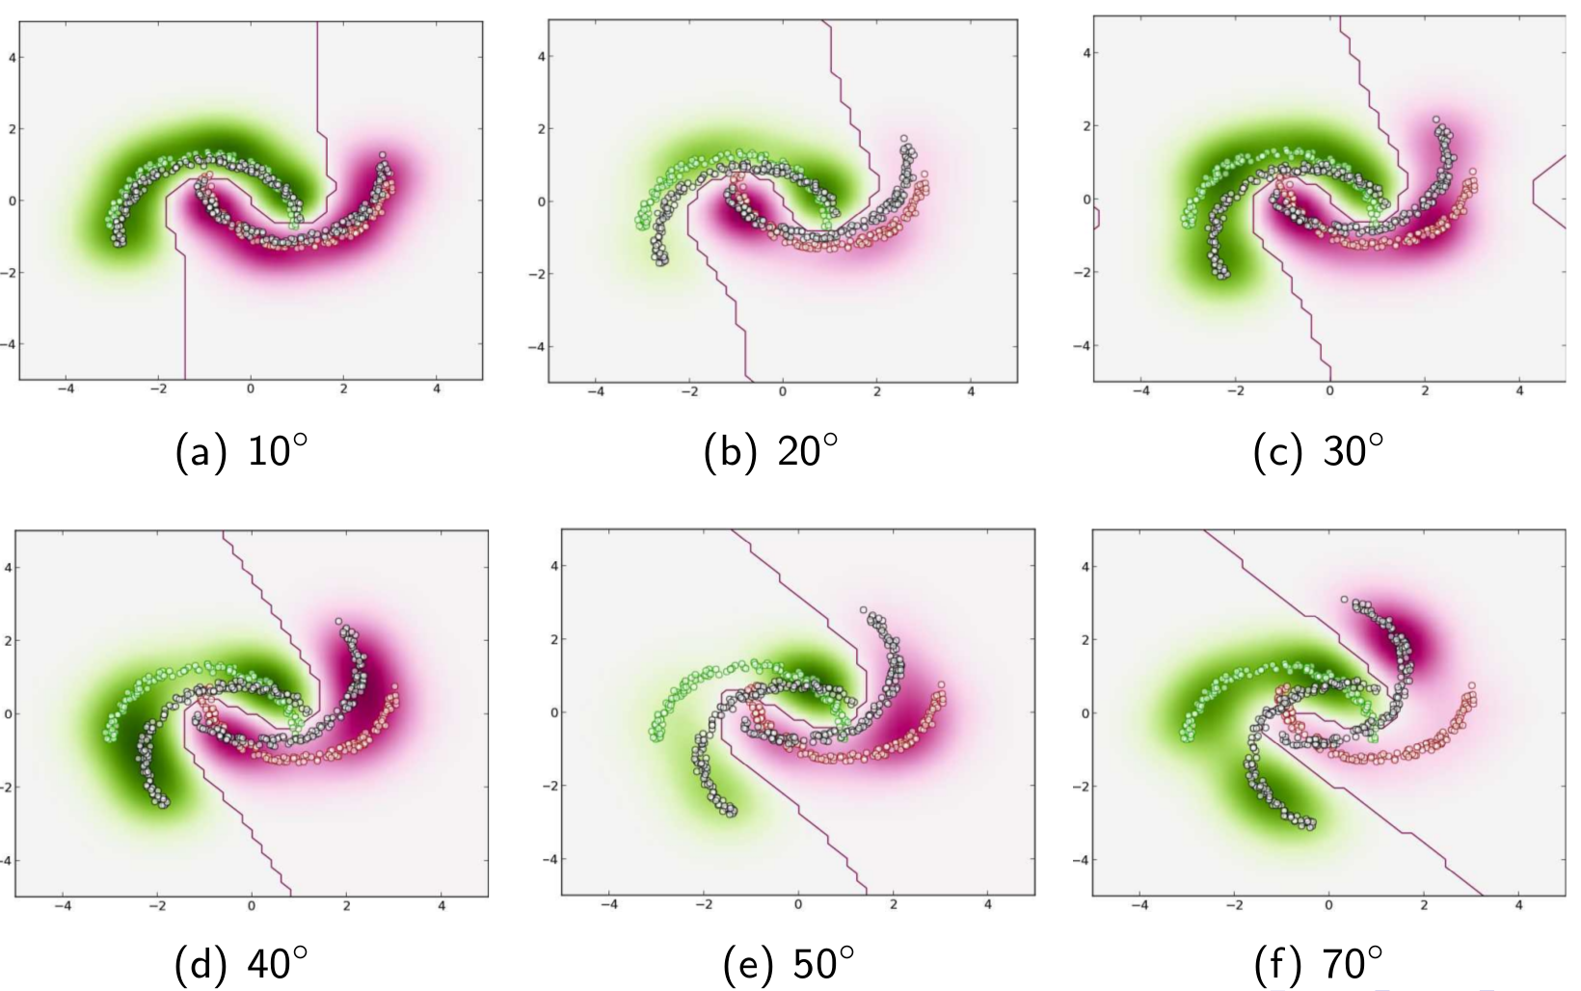
Toy Problem
“Intro to TL and Domain Adaptation” [Amaury Habrard, EPAT 2014]

Slide 6
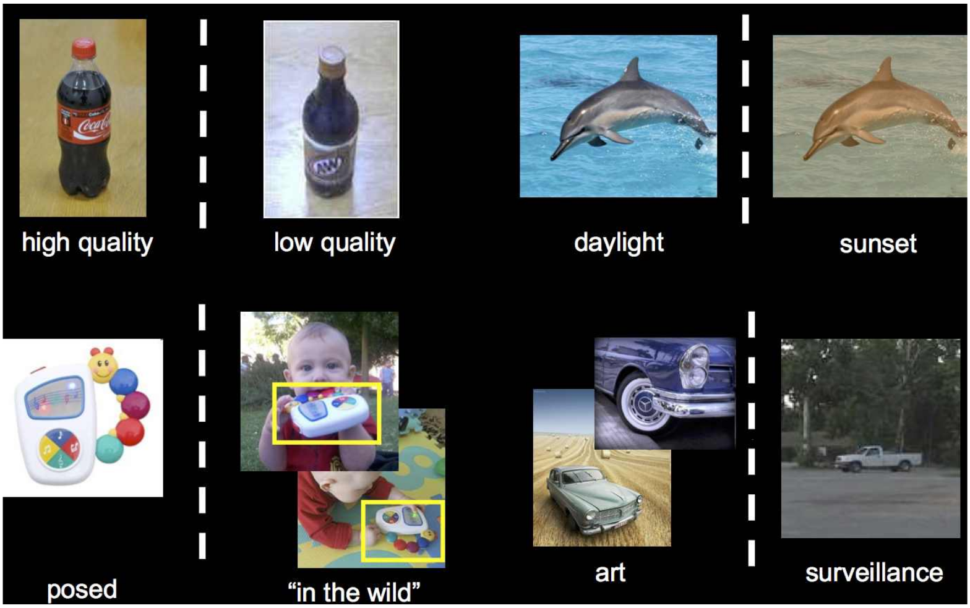
It is hard to predict what will change
“Domain Transfer Tutorial” [Xu,Saenko,Tsang, CVPR 2012]

Slide 7
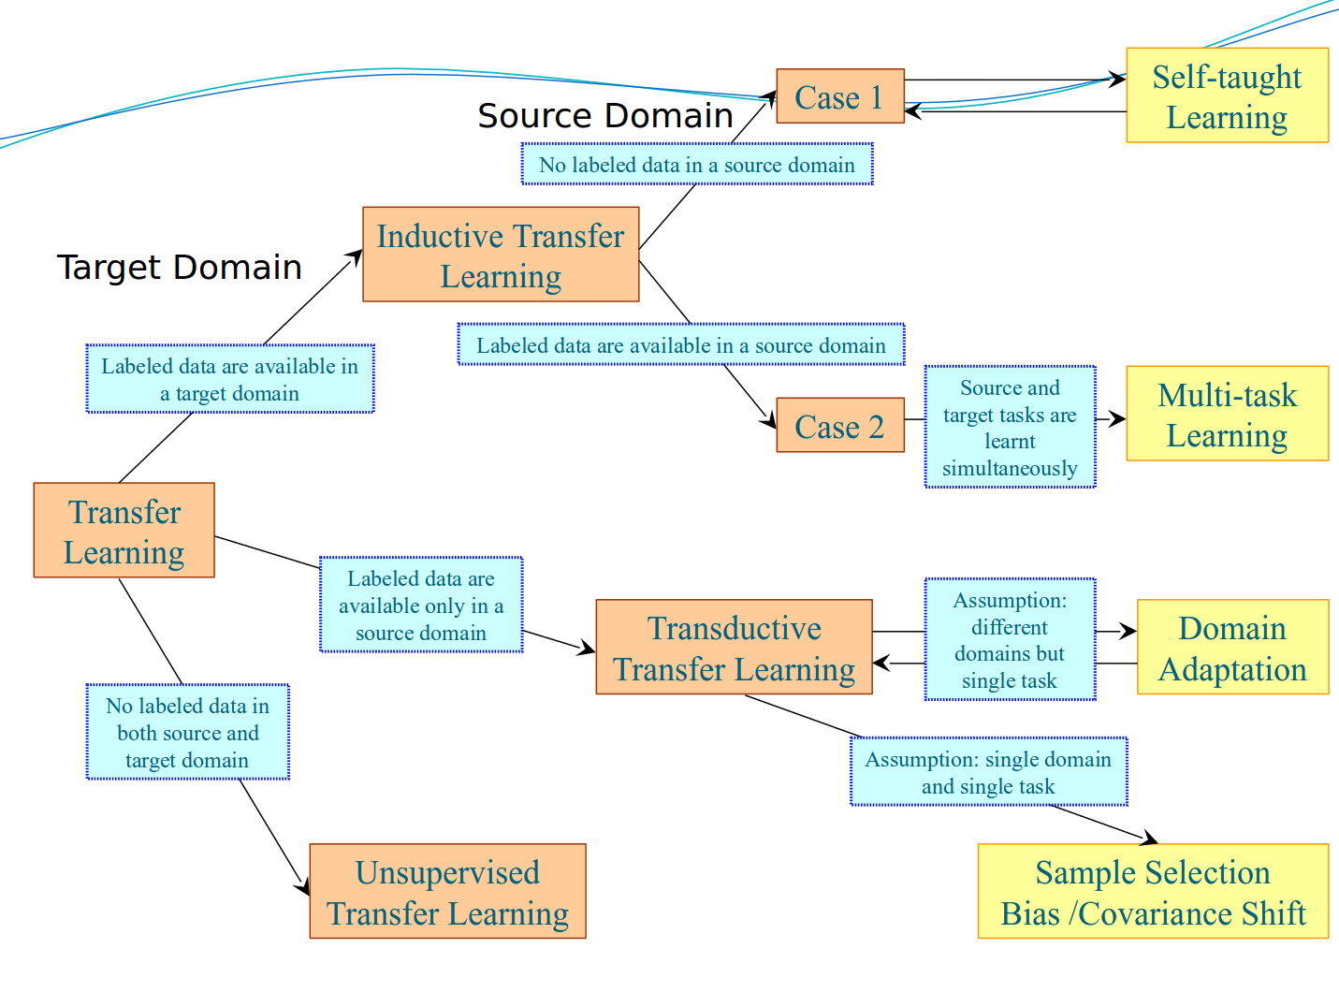
Transfer Learning Taxonomy
“A survey on Transfer Learning” [Pan and Yang, TKDE 2010]

Slide 8
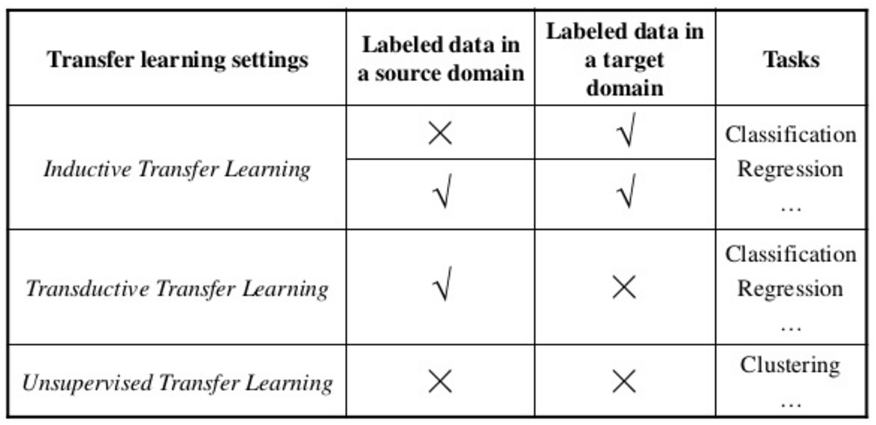
Transfer Learning Settings
“Text clustering” [Chennai, Anna University 2015]

Slide 9
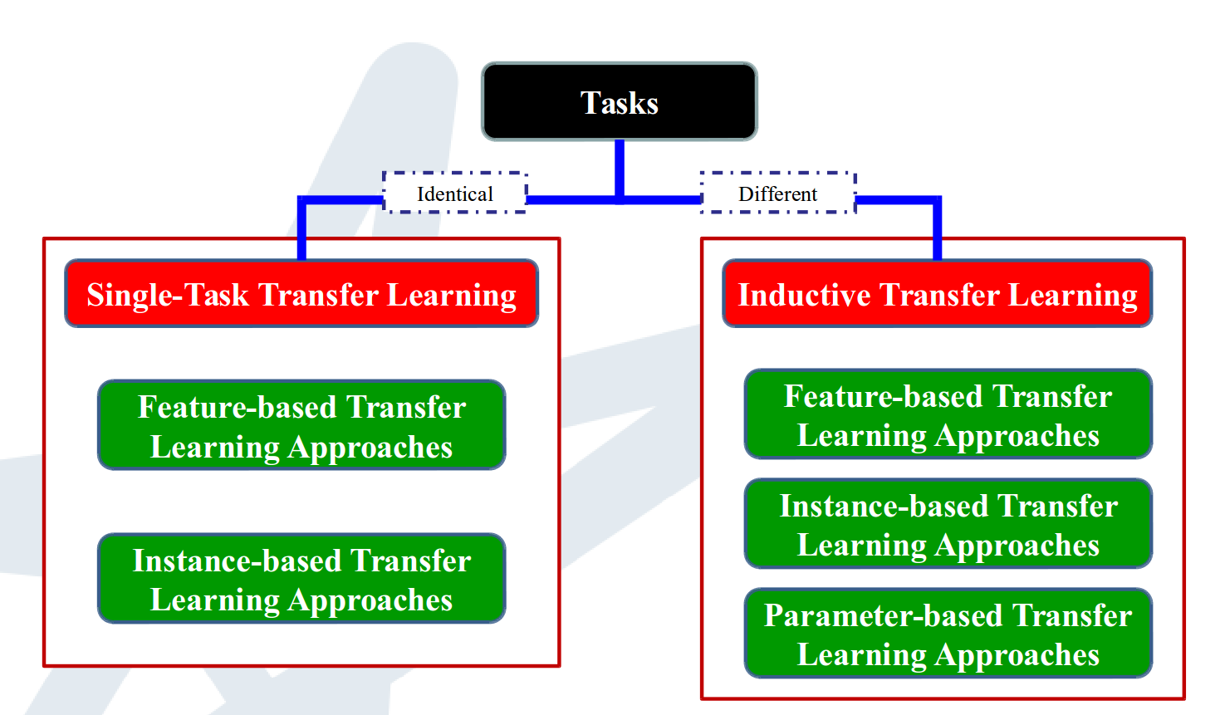
Categories of Algorithms
“Introduction to Transfer Learning” [Leews, NUS 2011]

Slide 10
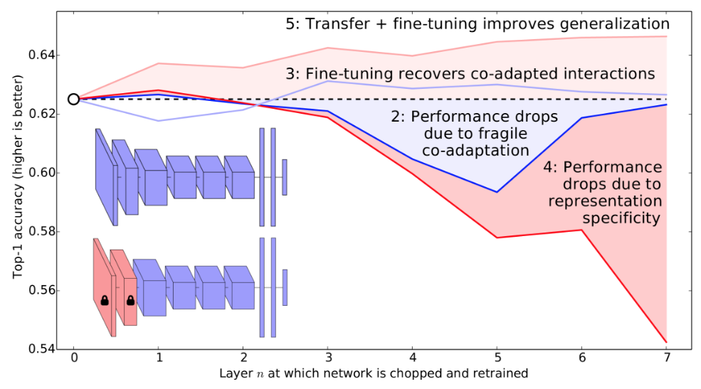
Move to
DNN’s transferability paper

Slide 11
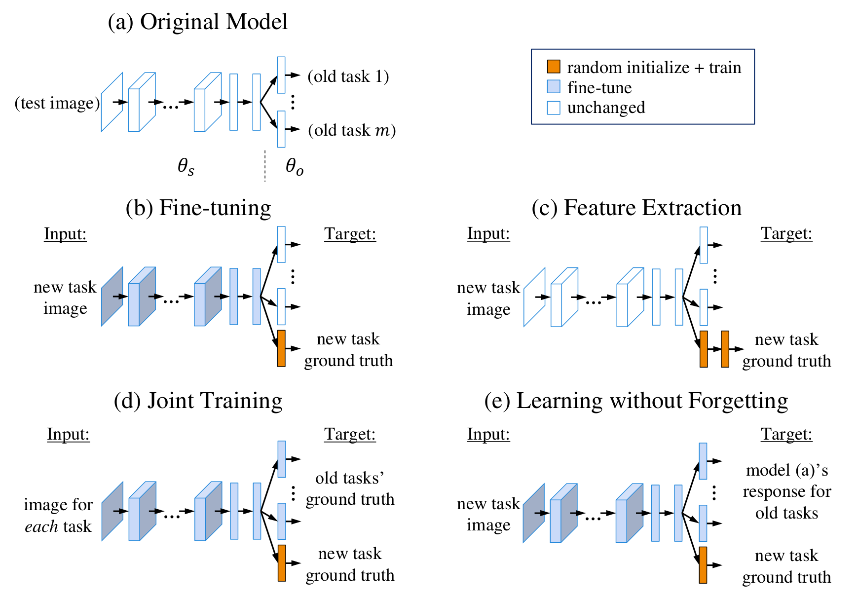
Learning without Forgetting
“Learning without Forgetting” [Zhizhong, IEEE 2016]

Slide 12
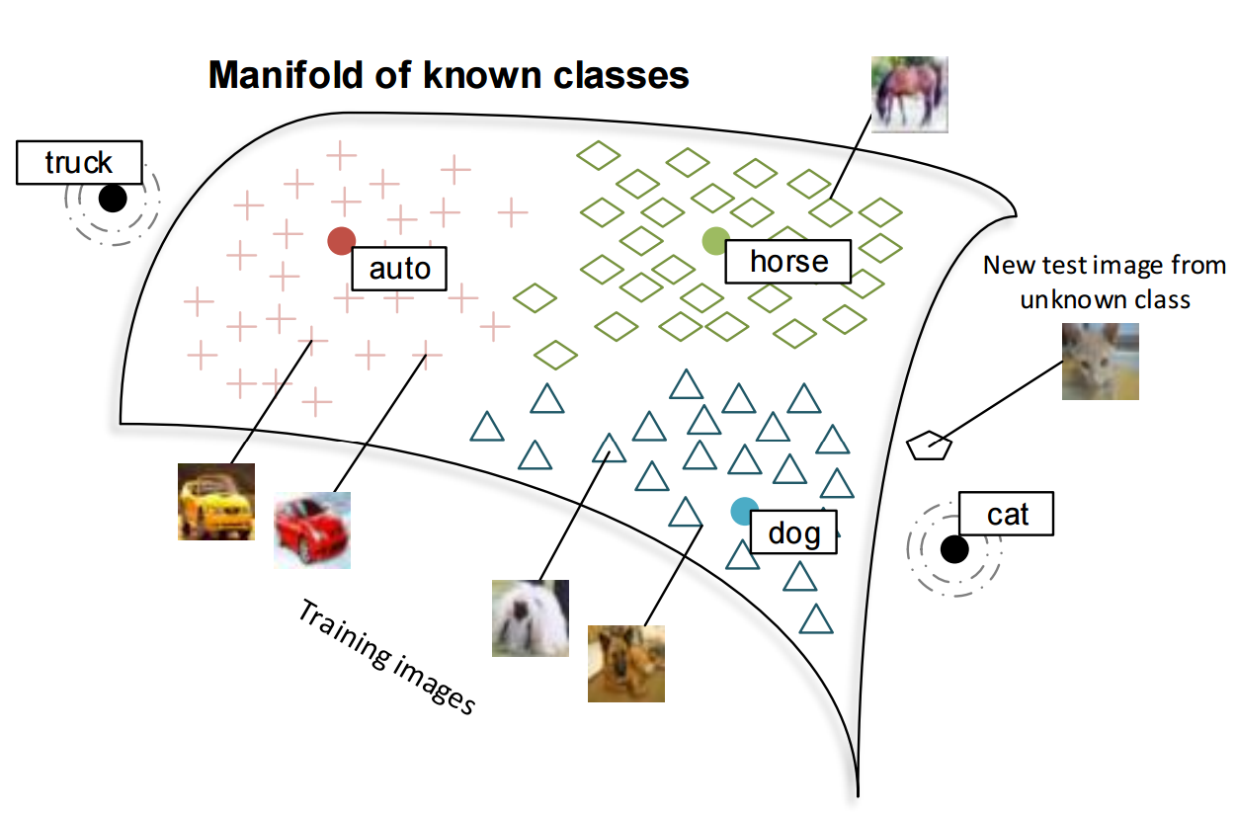
Zero-/One- Shot Learning
“Zero-Shot Learning Through Cross-Modal Transfer” [Andrew et. al., Stanford 2013]

Slide 13
Key Points
Transfer Learning is a general field which we can apply in many areas.
Deep Models tend to learn features that they were not specifically trained for.
Transferring the “knowledge” gained from one domain to another can increase the performance on a new task.
This is a very active research field with so many ideas flying around.

Slide 14
Useful links
A survey on Transfer Learning (2016) [https://journalofbigdata.springeropen.com/articles/10.1186/s40537-016-0043-6]
How Transferable are Features in DNNs (2015) [http://yosinski.com/transfer]
Domain Adaptation in Transfer Learning (2014) [https://epat2014.sciencesconf.org/conference/epat2014/pages/slides_DA_epat_17.pdf]
Learning without Forgetting (2016) [https://arxiv.org/abs/1606.09282]
Return of the devil in the details (2014) [https://arxiv.org/abs/1405.3531]

Slide 15
Useful links (contd.)
One-shot Learning (2016) [https://arxiv.org/abs/1606.04080]
CNN Features off-the-shelf (2014) [https://arxiv.org/abs/1403.6382]
DeCaf (2013) [https://arxiv.org/abs/1310.1531]
Practical Guidelines for Transfer Learning in Deep Models (2015) [http://cs231n.github.io/transfer-learning/]
Deep Neural Networks Visualization (2015) [http://yosinski.com/deepvis]

Slide 16
Thank you!
^_^

